Slide 1
AI

Slide 2
Artificial Intelligence
8.2.6.
Advanced Search (Ch 4) Part 2

Slide 3
Outline
Local search algorithms
Hill-climbing search
Simulated annealing search
Local beam search
Genetic algorithms

Slide 4
Local search algorithms
In many optimization problems, the path to the goal is irrelevant; the goal state itself is the solution
State space = set of "complete" configurations
Find configuration satisfying constraints, e.g., n-queens
In such cases, we can use local search algorithms
keep a single "current" state, try to improve it

Slide 5
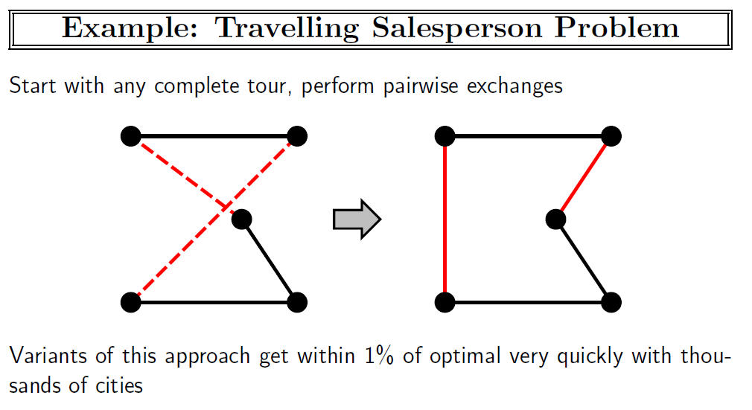

Slide 6

Example: n-queens
Put n queens on an n × n board with no two queens on the same row, column, or diagonal

Slide 7
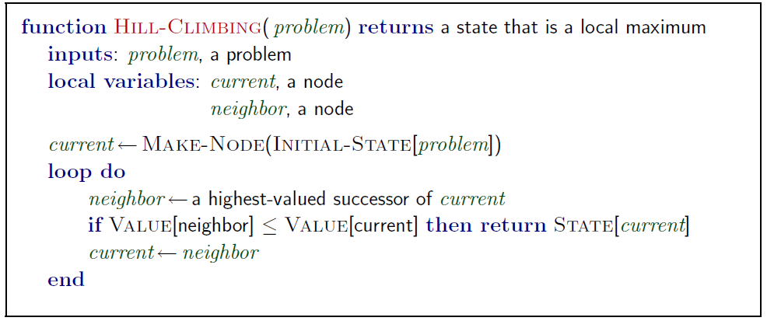
Hill-climbing search
"Like climbing Everest in thick fog with amnesia"

Slide 8
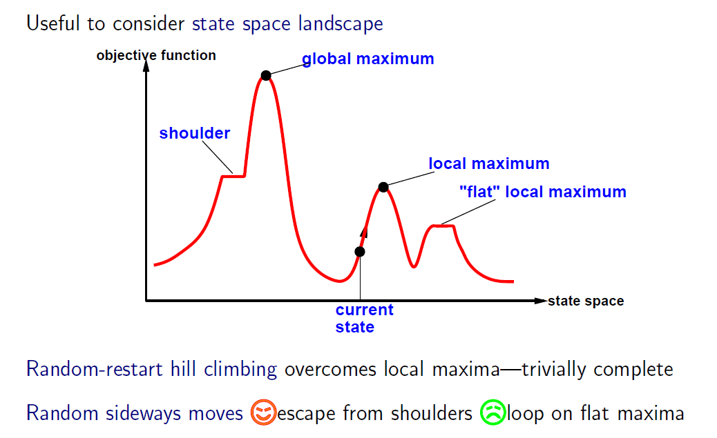
Hill-climbing search
Problem: depending on initial state, can get stuck in local maxima

Slide 9
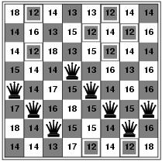
Hill-climbing search: 8-queens problem
h = number of pairs of queens that are attacking each other, either directly or indirectly
h = 17 for the above state

Slide 10
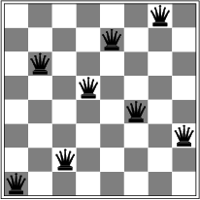
Hill-climbing search: 8-queens problem
A local minimum with h = 1

Slide 11
Demos
http://eightqueen.becher-sundstroem.de/
http://cliplab.org/~jfran/ptojs/queens_ui/queens_ui.html

Slide 12
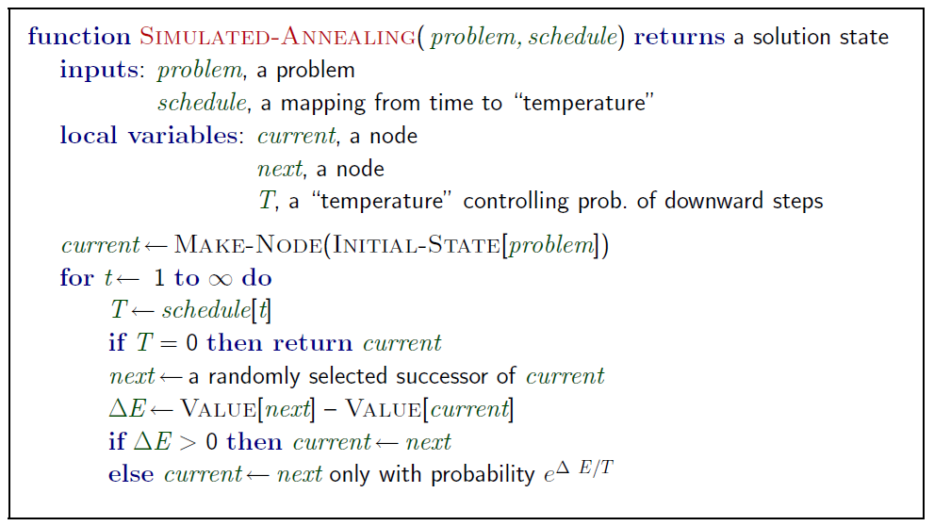
Simulated annealing search
Idea: escape local maxima by allowing some "bad" moves but gradually decrease their frequency

Slide 13
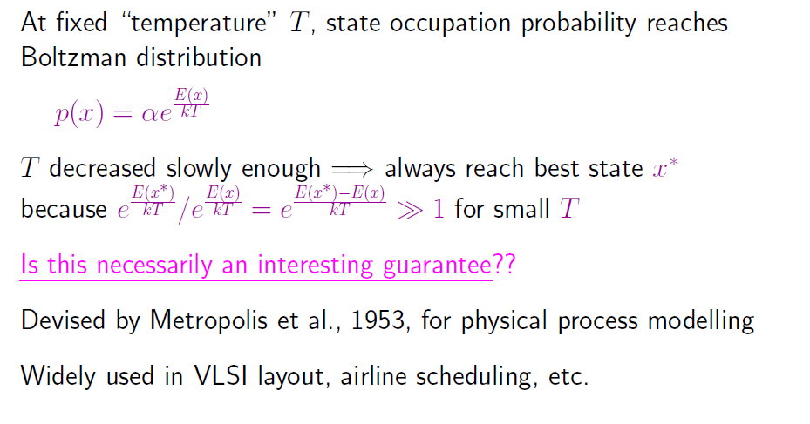
Properties of simulated annealing search

Slide 14
Local Beam Search
Keep track of k states rather than just one
k is called the beam width
Start with k randomly generated states
At each iteration, all the successors of all k states are generated
If any one is a goal state, stop; else select the k best successors from the complete list and repeat.

Slide 15
Genetic algorithms
A successor state is generated by combining two parent states
Start with k randomly generated states (population)
A state is represented as a string over a finite alphabet (often a string of 0s and 1s)
Evaluation function (fitness function). Higher values for better states.
Produce the next generation of states by selection, crossover, and mutation.

Slide 16
Genetic algorithms contd.
What is the fitness function?
How is an individual represented?
Using a string over a finite alphabet.
Each element of the string is a gene.
How are individuals selected?
Randomly, with probability of selection proportional to fitness
Usually, selection is done with replacement.
How do individuals reproduce?
Through crossover and mutation

Slide 17
GA Pseudocode
Choose initial population (usually random)
Repeat (until terminated)
Evaluate each individual's fitness
Select pairs to mate
Replenish population (next-generation)
Apply crossover
Apply mutation
Check for termination criteria

Slide 18
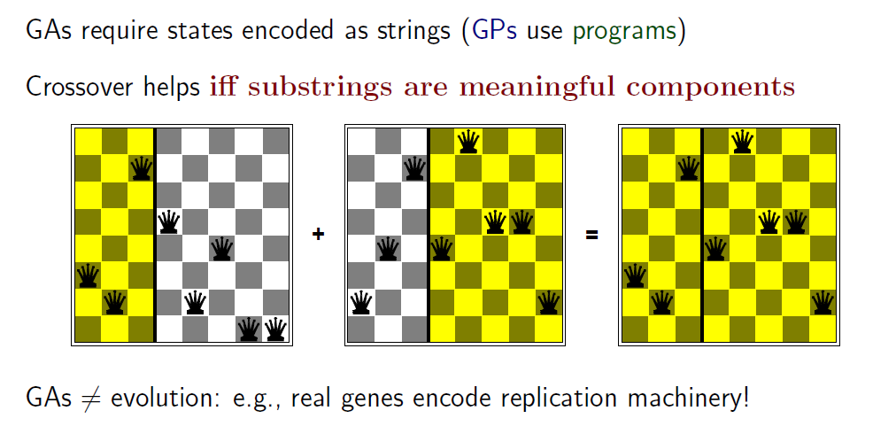
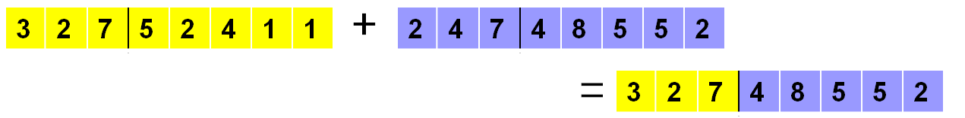
Genetic Algorithms

Slide 19
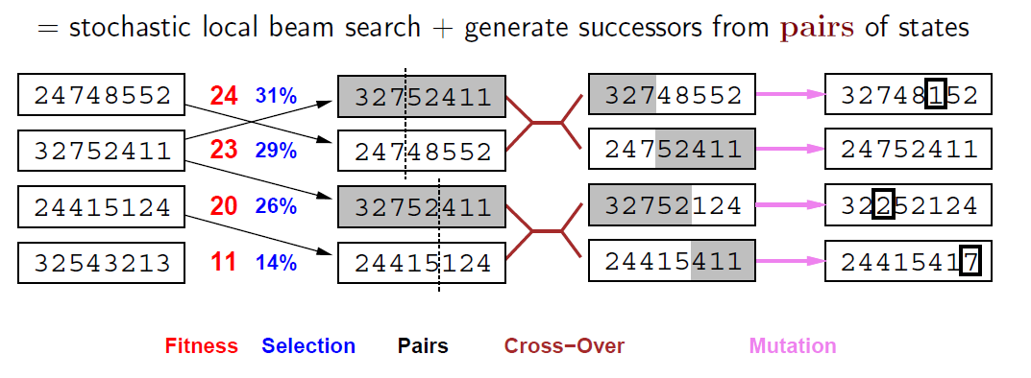
Genetic algorithms
Fitness function: number of non-attacking pairs of queens (min = 0, max = 8 × 7/2 = 28)
24/(24+23+20+11) = 31%
23/(24+23+20+11) = 29% etc.

Slide 20
Replacement
Simple or generational GAs replace entire population
Steady state or online GAs use different replacement schemes:
Replace worst
Replace best
Replace parent
Replace random
Replace most similar

Slide 21
Demo
% python ga.py 10 4 | more
Initial Population
individual bitarray('010011001000') fitness 4
individual bitarray('000001001000') fitness 2
individual bitarray('001000000000') fitness 2
individual bitarray('000010000011') fitness 4
individual bitarray('010011001001') fitness 3
individual bitarray('011010001001') fitness 2
individual bitarray('001001011010') fitness 3
individual bitarray('000010000011') fitness 4
individual bitarray('011010010001') fitness 3
individual bitarray('010000010000') fitness 4
average 3.1
…
average 3.7
…
average 3.9
…
average 4.2
…
parent_x bitarray('001011000010')
parent_y bitarray('011011000010')
crossover_pt 2
child bitarray('001011000010')
individual bitarray('001011000010') fitness 6
2 4 1 3

Slide 22
Car Design Simulation
http://www.boxcar2d.com/
http://www.boxcar2d.com/about.html

Slide 23
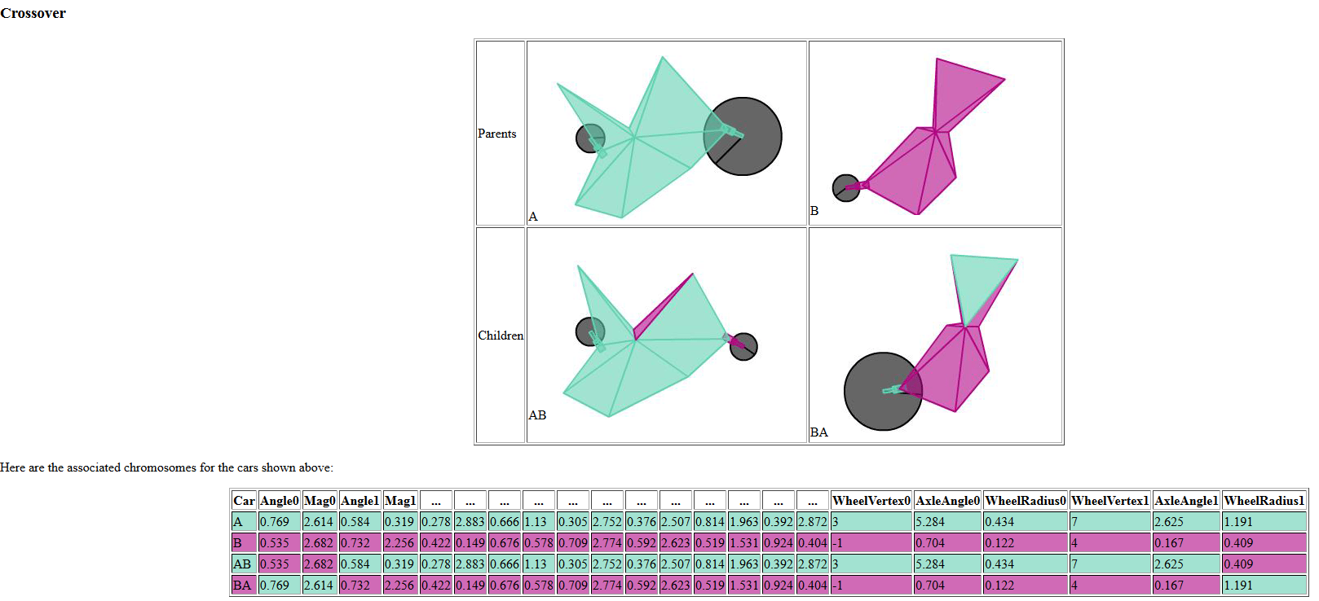

Slide 24
Genetic Algorithms Links
http://math.hws.edu/eck/jsdemo/jsGeneticAlgorithm.html
http://www.theprojectspot.com/tutorial-post/simulated-annealing-algorithm-for-beginners/6
http://www.theprojectspot.com/tutorial-post/applying-a-genetic-algorithm-to-the-travelling-salesman-problem/5
http://www.theprojectspot.com/tutorials/page/2
http://genetic-algorithms-explained.appspot.com/

Slide 25
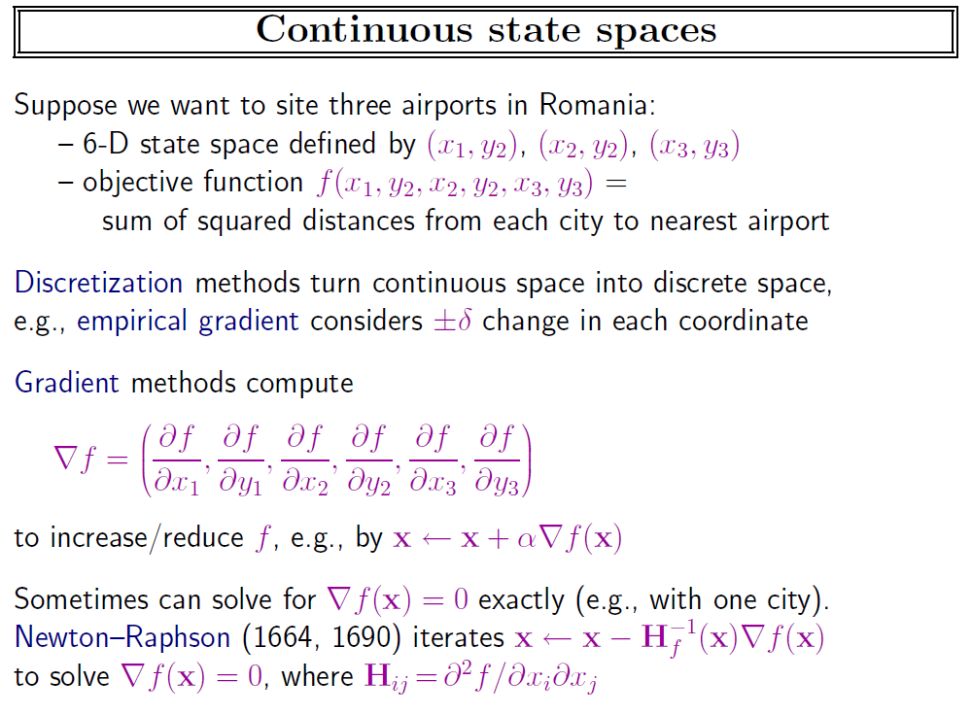

Slide 26
AI

